Slide 1
CLAS 220 Introduction to Classical Mythology
Euripides: Medea

Slide 2
Quiz Question
What was the mission of the Argonauts?
To retrieve the Golden Fleece
To kill the Calydonian Boar
To defeat the monster Argo
To capture the city of Argos

Slide 3
Quiz Question
2. Where are Jason and Medea at the beginning of the play?
Athens
Colchis
Iolchos
Corinth

Slide 4
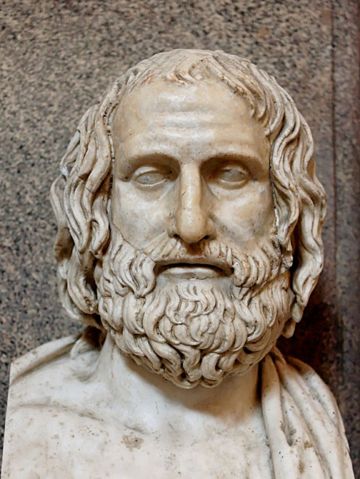
Euripides the man
Born 480's, dies 407/6
(Compare to Sophocles, 496-406)
Sometimes said to be from wealthy family;
sometimes from family of grocers
competes at Dionysia from 455 onwards;
only wins four times (over ninety plays)
the trilogy including Medea came in third
reputation rose after death
eighteen plays survive: ten from a manuscript of "greatest hits" taught in school; eight from alphabetical manuscript
retires to Macedon
three stories about death:
1. rival poets bribe master of hounds
2. torn to pieces by women while on his way to king's boy lover
3. killed on the way to tryst with another man's wife

Slide 5
Euripides the dramatist
reduced role for the chorus
greater interest in individual psychology
emphasis on female characters
13/18 plays have titles from female character/chorus
Sophocles showed people "as they should be,"
Euripides shows them "as they are"
rhetorical debate
between characters
within single character
interest in hero-cult
each of the plays we're reading ends with establishment of a hero-cult

Slide 6
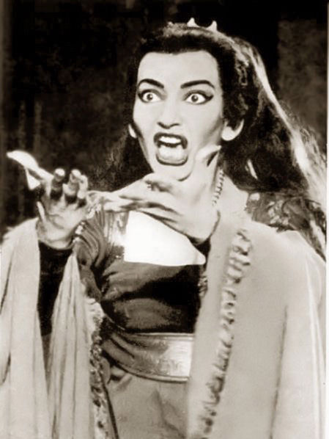
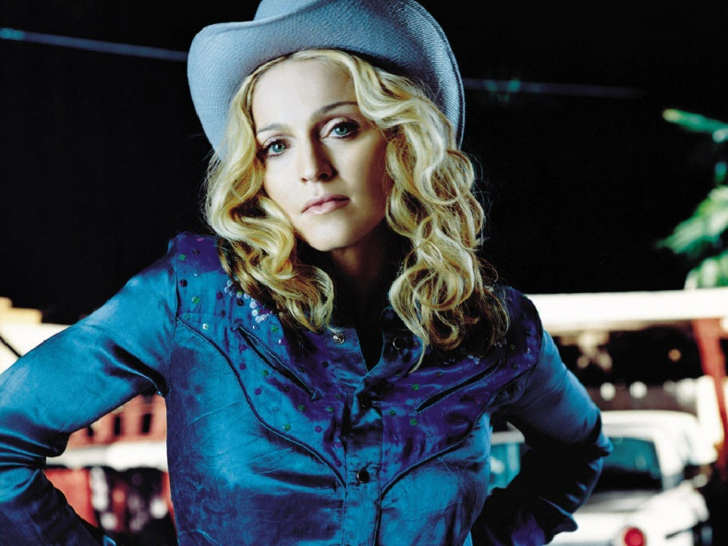
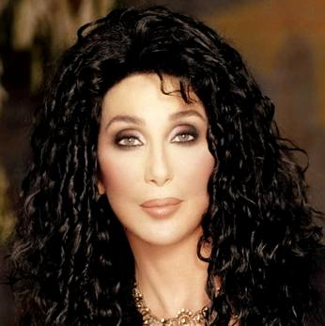
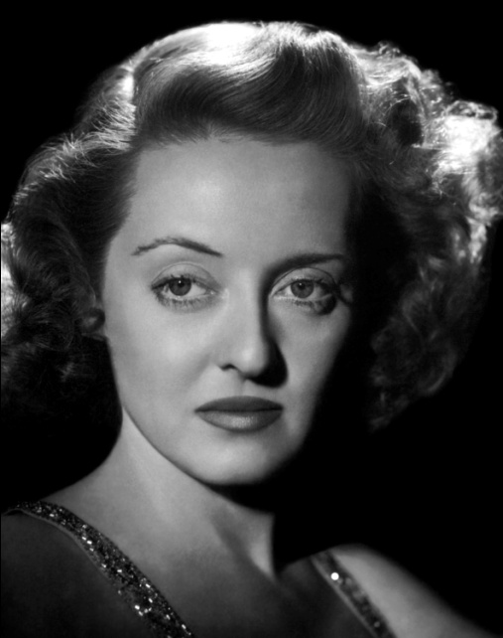
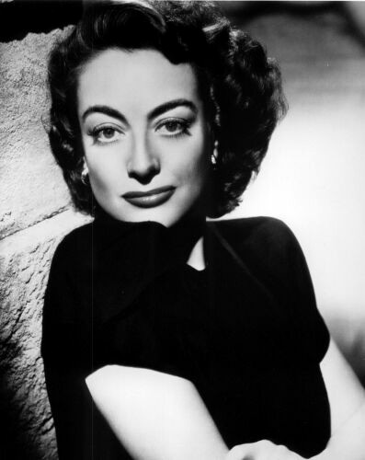


The Diva

Slide 7
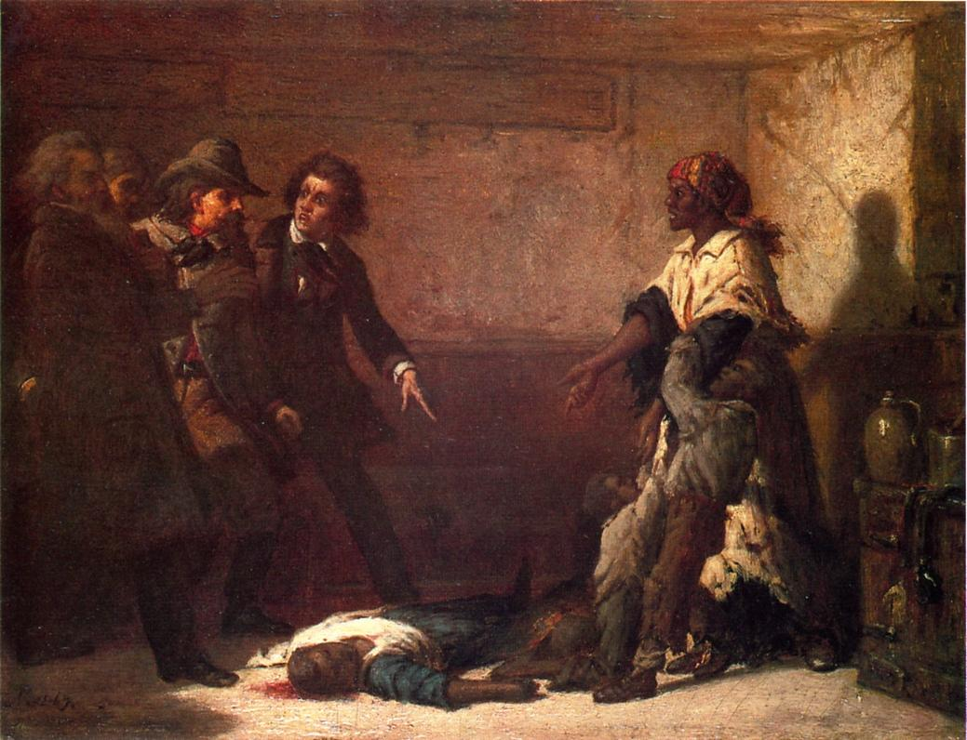

The Modern Medea
Margaret Garner, an escaped slave who killed her daughter in 1856 rather than let her return to slavery in Kentucky
inspiration behind Toni Morrison's novel Beloved

Slide 8
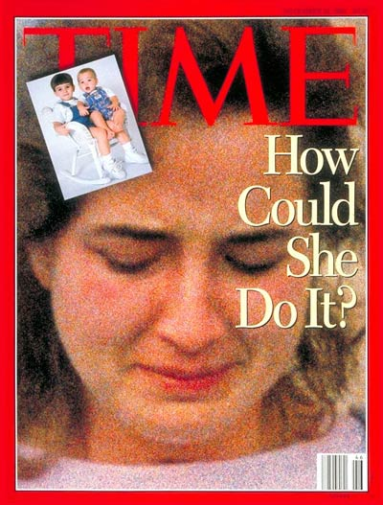
A different modern Medea
Susan Smith, convicted in 1995 of killing her children, after first claiming she'd been the victim of a carjacking.

Slide 9
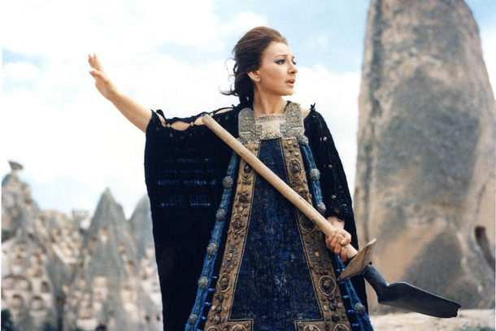
Cinematic Medea (I)
Pier Paolo Pasolini, Medea, 1969

Slide 10
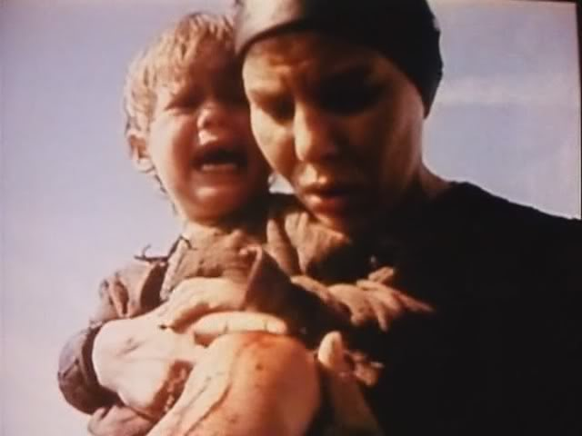
Cinematic Medea (II)
Lars von Trier, Medea, 1988.

Slide 11
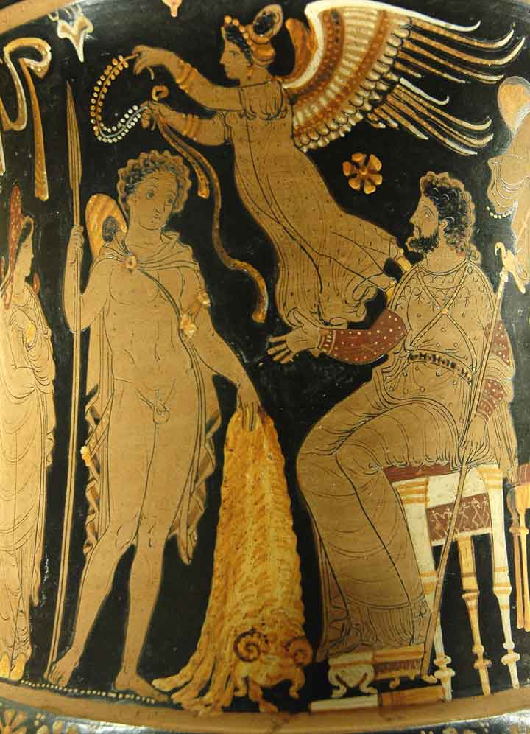
The Story So Far…
Pelias usurps the throne of Iolcos from his brother Aeson
Aeson has a son, whom he pretends has died
The boy is raised by a centaur, and named Jason
Jason returns to Iolcos one day, wearing only one sandal
This fulfills a prophecy, and Pelias recognizes him
To get rid of Jason, Pelias asks him to go to Colchis to capture the Golden Fleece

Slide 12
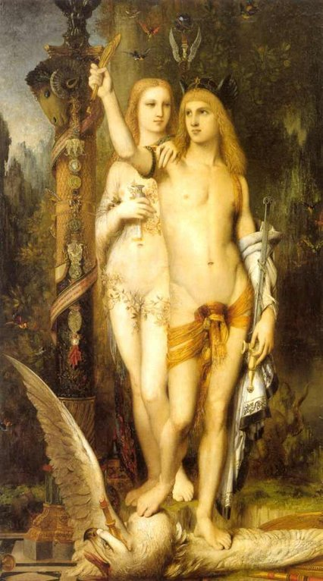
The Story So Far… (2)
Jason gathers other heroes, and they set sail on the first ship, the Argo
They have a variety of adventures on the way
When they arrive in Colchis, the king’s daughter, Medea, helps Jason and the Argonauts succeed in the various tasks that they must complete
Then, on their escape, she kills her brother to distract her father and facilitate their escape

Slide 13
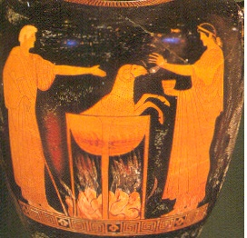
The Story So Far (3)
When Jason and Medea return to Iolcos, Pelias still won’t give up the throne
Medea gets his daughters to kill him by tricking them into thinking they can give their father eternal life
First, she chops up a ram into little pieces, then boils it with secret herbs. A young lamb emerges from the pot.
Then, she encourages Pelias’ daughters to do the same, only she doesn’t give them the right herbs…
Jason and Medea decide to leave Iolcos
They end up in Corinth

Slide 14
Quiz Question
3. What does Medea beg for from Creon?
A city of her own to rule
One more day to prepare her departure
His hand in marriage
The death of Jason

Slide 15
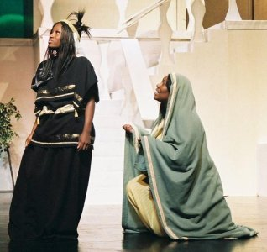
The Nurse
Ah! I am the one who is most miserable.
What share do your children have in the wrongdoing
Of their father. Why do you hate them?
Oh, children, how I grieve for what you may suffer.
Terrible is the temperament of royalty
Who, perhaps because they are rarely overruled
And always imperious, shift their moods violently.
In any event to become accustomed to living
On the basis of equality is better.
115-123

Slide 16
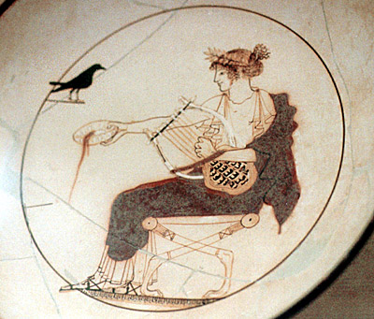
Music Isn’t Going to Cut It
… Yet she glares at her servants like a mother lioness,
When anyone comes near her to speak.
You wouldn’t be mistaken if you called
Those men of the past stupid, not sophisticated,
Who discovered songs for festivities,
Banquets and dinner parties –
Sweet sounds for our lives.
But no mortal has discovered how to stop
Hateful human sufferings with music
And the intricate chords of the lyre’s songs.
187-196

Slide 17
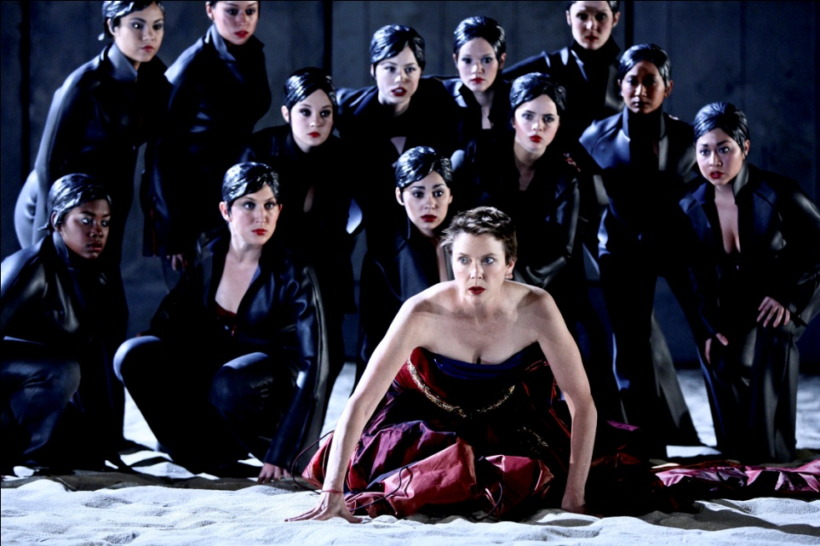
Medea Speaks to the Townswomen
Of all creatures that live and have understanding
We women are the wretchedest breed alive;
First, we must use excessive amounts of cash
To buy our husbands, and what we get are masters
of our bodies. This is the worst pain of all.
In fact, this is the greatest struggle, whether he’ll be
A good or bad one, for divorce brings no repute
To wives, and yet they can’t deny their husbands.
So coming into new rules and customs,
She must be a prophet, since she hasn’t learned at home
How to deal in the best way with her bed-mate.
And if we manage to find a solution to this,
So husbands live with and don’t feel chained to us,
Our lives are a joy; but if not, it is necessary to die.
230-243

Slide 18
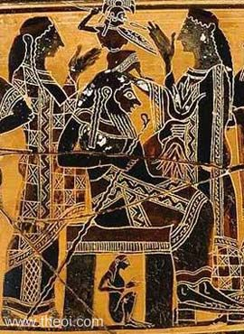
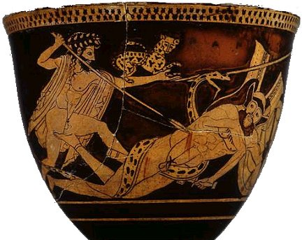
Medea Speaks to the Townswomen
They say that we spend all our time at home,
And live safe lives, while they go out to battle.
What fools they are! I’d rather stand three times
Behind a shield than bear a child once!
248-251

Slide 19
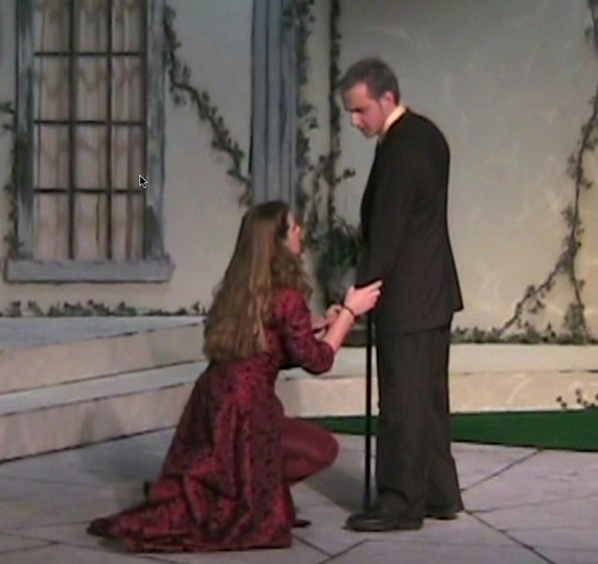
Creon to Medea
I fear you – no need to dress up the language –
Fear you’ll work some incurable harm to my daughter.
And many things contribute to this fear:
You’re clever and much versed at doing harm,
And you’re grieving the loss of your husband’s bed.
I hear you’ve threatened – that’s the report that came –
To do something to me who gave her and to the bride
And to the bridegroom – that’s what I must guard against.
It’s better for me to feel your hatred now, woman,
Than lament loudly later for showing softness.
282-291

Slide 20
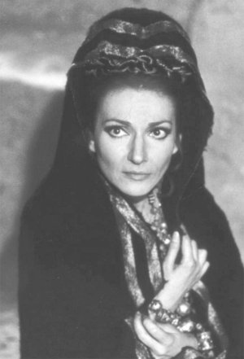
Medea Plots
I have so many ways of killing them,
I don’t know which I’ll try out first, my friends.
Perhaps I’ll set fire to the bridal chambers,
Silently stealing into the room where the bed is spread.
But one pitfall, there, for me: if I’m caught
Creeping into the house and plotting something,
My death will give my enemies a laugh.
Best to take the direct route, where my natural
Skills can shine: murder them with poisons.
…
And what is more, we’re women,
Quite unable to manage good, but none more skilled
When it comes to crafting every kind of evil.
376-85; 407-09

Slide 21
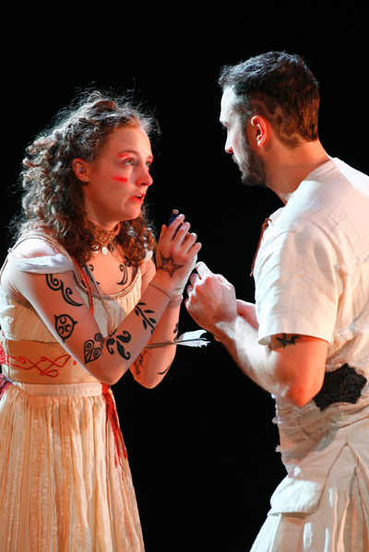
Jason Defends Himself
I’ve always tried to smooth the ruffled temper
Of the princes, and I wanted you to stay!
But you don’t give up your folly, continually
Carping at the rulers, so you’ll be expelled.
In spite of this I haven’t rejected my loved ones,
But have come out of forethought for you, woman,
So you won’t go into exile with the children,
Penniless, destitute. Exile brings with it
A flock of sorrows. For even though you hate me,
I could never harbor malicious thoughts against you.
455-64

Slide 22
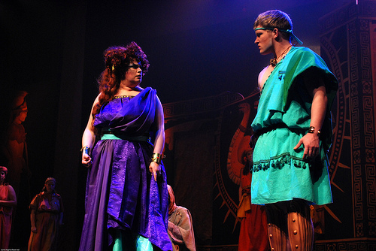
Medea’s Response
Well, then, I shall deal with you as a friend:
What good am I supposed to get from you?
Still, if I ask, you’ll be shown up as more shameful.
Now where should I go? To my father’s house?
To my country which I betrayed to come with you?
To Pelias’ wretched daughters? Of course, they would
Welcome the slayer of their father into their home!
This is how things are: to my nearest and dearest
I stand an enemy, and those I shouldn’t have wronged
Are now my enemies because I did you a favor.
499-508

Slide 23
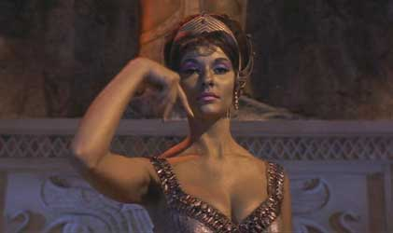
Jason’s Response
I must, it seems, not fall short of perfection
In speaking, but just like an expert helmsman,
Haul up my sail and run before the storm
Of harsh words your tongue spews, woman….
First, instead of a barbarian land,
Greece is your country now; you have a taste of justice
And the use of laws not subject to force.
All the Greeks can see that you are wise,
So you have renown, but if you lived at the ends
Of the earth, no one would take account of you.
522-5; 536-41

Slide 24
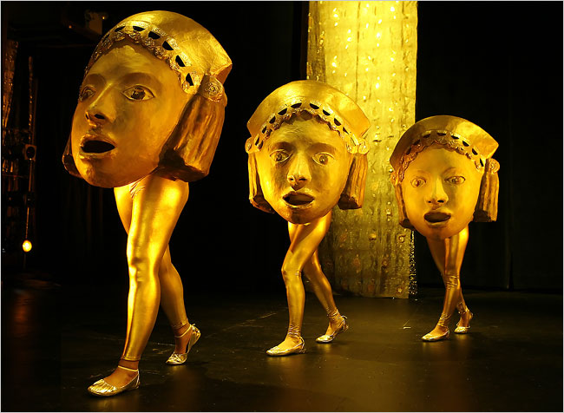
Choral Wisdom
When passionate desires
Descend in full force they never enhance
Men’s fame or virtue,
But if Aphrodite approaches
With reserve, there is
No goddess so gracious in her favors.
Mistress, never use me as a target,
Shooting golden arrows
Tipped with desire, unerring in aim.
Cherish me, Lady Restraint (sôphrosunê)
Noblest gift of the gods.
And may fearsome Aphrodite never hurl
Contentious passions and insatiable strife
Against me, shattering my spirit
With longing for the beds of other men.
And may she shrewdly judge our bed-partners,
Honoring those women’s bridal-beds
That stay free from war.
627-43

Slide 25
Quiz Question
4. What does Aegeus want Medea to help him with?
Killing his brother
Defeating Corinth in battle
Having children
Making a fortune

Slide 26
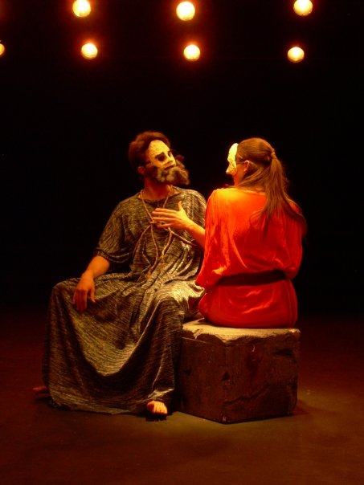
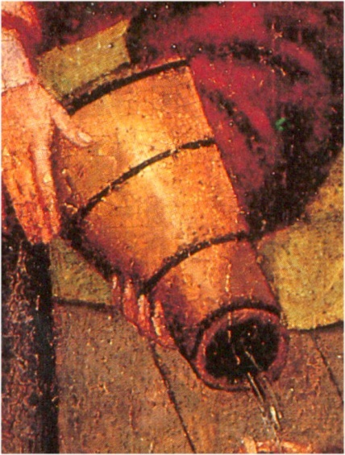
Medea and Aegeus
M: By the gods! You’re childless at your time of life?
A: Childless, indeed, by some cruel stroke of fate.
M: You’re married? You’ve had experience with women?
A: Indeed, it’s not for lack of a wife or marriage.
M: What did Apollo tell you about children?
A: Words too wise for a man to understand.
M: Is it right for me to know the god’s response?
A: Certainly, for a clever mind indeed is needed.
M: What did he say, then? Speak, if it is allowed.
A: Not to release the wine-skin’s hanging neck –
M: Until you do what, come to what place?
A: Until I come to my father’s hearth once more.
670-81

Slide 27
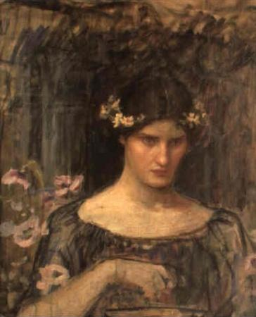
Medea Explains Her Plans
Now I shall tell you exactly what I’m planning;
You’ll hear, but not rejoice at what I say….
The children I’ll send off to the bride with gifts
In their hands, asking not to go into exile –
A fine-textured robe and a golden garland.
And if she takes the adornment and puts it on,
She and all who touch the girl will die.
Such is the poison with which I’ll anoint the gifts.
There, I’m finished with that part of the plot.
But I groan at the task that I must proceed
To accomplish. For I shall put the children to death –
My children. No one will save them from me.
When I have utterly ruined Jason’s whole house,
I shall leave the country, accused of my dear children’s
Murder, and having dared the unholiest of deeds.
For to be laughed at by enemies is intolerable, friends.
So what profit is there for me in living?
772-3; 784-797

Slide 28
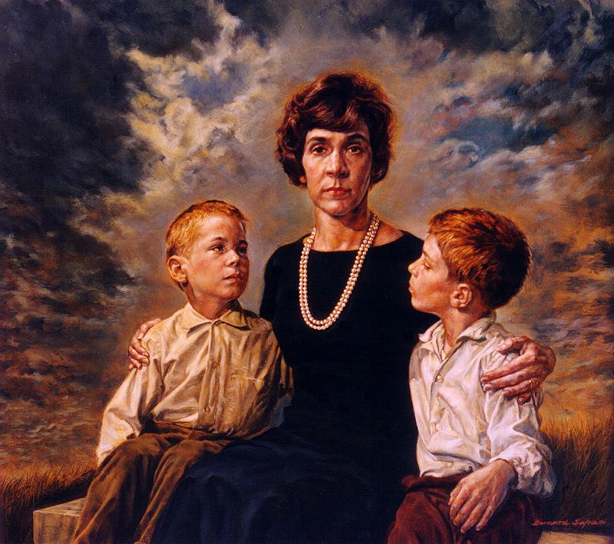
Medea Laments the Children She Will Kill
Ah, children, children, you’ll have a city and a home
In which you’ll always live, deprived of me,
Your mother, whom you’ll leave behind in her misery.
But I shall go to another land as an exile
Before benefiting from you and seeing you prosper,
Before preparing your pre-nuptial baths and your brides,
Before adorning your marriage-beds and holding high
The wedding torches. O, how miserable my inflexible will has made me!
For nothing, then, my children, I tended you,
For nothing I labored and wore myself down with toil,
Enduring harsh labor-pains at your births.
Oh, the hopes I had once for you were many
-- that you would keep me in old age
And, when I died, deck me out properly,
A sight for men to envy. Now, it’s gone,
That sweet concern. Deprived of you two
I shall drag out a grievous and painful life
And you will never again see with your dear eyes
Your mother, after leaving for another form of life.
1021-39

Slide 29
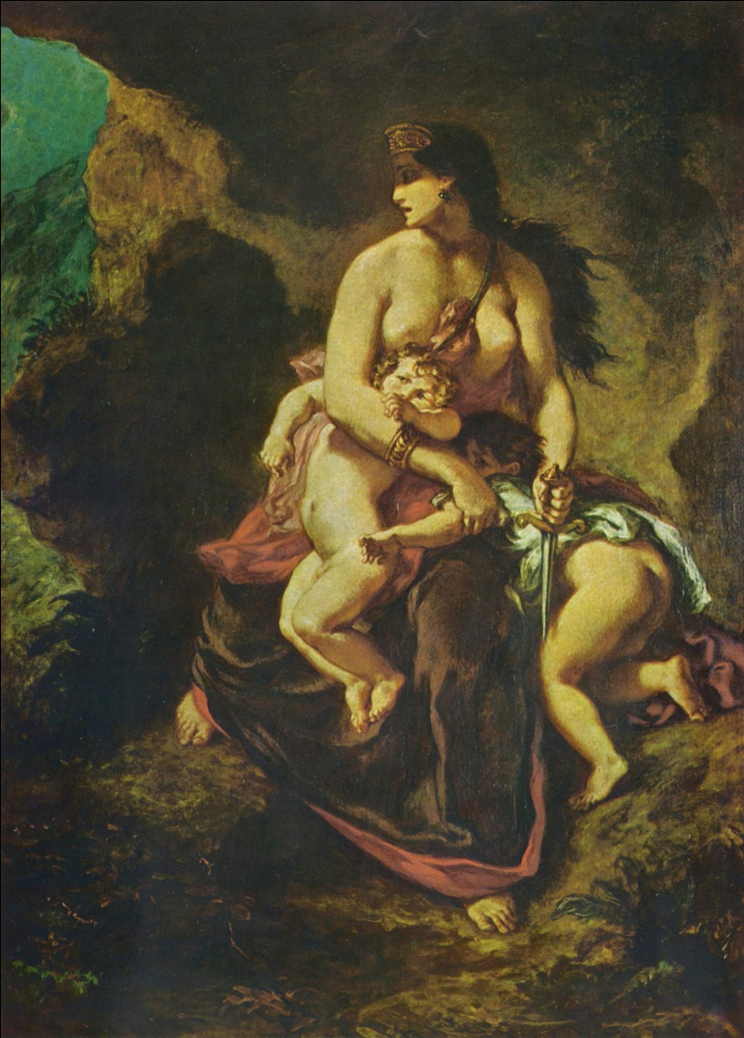
Medea Reconsiders, Briefly
O god! Why do you turn your eyes to me,
Children? Why smile this final smile?
Ahh! What should I do? I have no heart,
Women, when I see the bright eyes of the children.
I can not. Good-bye to those plans made before.
I shall take my children from the land.
Why should I harm them, to hurt their father,
When I would harm myself twice as much?
No, I will not. Farewell to my plans.
And yet, what’s wrong? Do I want to be laughed at?
For letting my enemies off scot-free?
The deed must be done! Ugh! The weakness
Of even letting soft thoughts into my mind.
Go into the house, children.
The one for whom it is not right to attend my sacrifice,
Beware! My hand shall not be turned from its purpose!
1040-1055

Slide 30
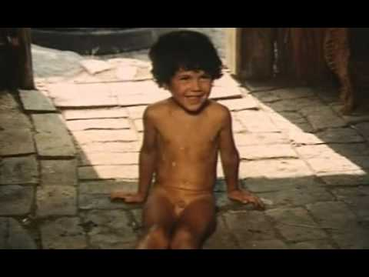
More Choral Wisdom
First, how to feed and raise them,
And leave them enough to live on.
Then, whether they’re laboring
For good children or bad is unclear.
Let’s say they’ve successfully raised them:
Their children are now grown up,
And they’re good. Then, if a divinity
So decrees, Death snatches
The children away to Hades.
What profit, then, for mortals
If the gods add to our other woes
This most painful grief,
Only for the sake of children?
1081-1115
My conclusion is that people
Who’ve never borne children
Are much happier
Than parents.
The childless have no experience
Whether children bring happiness
Or sorrow – they don’t have them!
They’ve missed many sufferings.
But those who have at home
A delightful brood, I see them
Worn out by constant concerns:

Slide 31
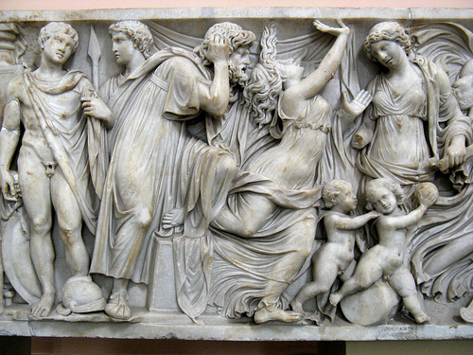
Glauke Tries On Her Wedding Present
Her complexion turned pale; she stumbled
Sideways; her body shook. She hardly managed
To reach her chair without falling flat on the floor.
One of her old serving women, supposing
That a fit of Pan or some other god was upon her,
Cried out for joy, but then she saw around her mouth
The white foam oozing, the eyes in their sockets
Rolling wildly, the blood all gone from her skin.
1168-75

Slide 32
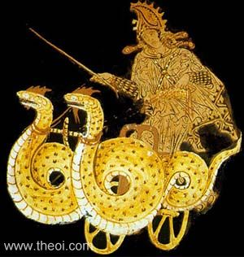
Jason and Medea Speak Again
M: So then, call me a lioness, if you like,
Or a Scylla who dwells in the land of Etruria,
For I’ve fittingly driven my sting into your heart.
J: Yet you grieve, too, and share in the disaster.
M: True, but grief is gain, if it stops you laughing at me.
J: O, children, what an evil mother you encountered!
M: O, children, how your father’s illness killed you!
J: At least it wasn’t my right hand that killed them.
M: No, your insults and your newly-formed marriage.
J: Did you really think it proper to kill them because of the marriage-bed?
M: Do you think that this is small suffering for a woman?
J: For a self-controlled woman, but for you a world of evil.
M: These children no longer live; that will sting you.
1358-1370

Slide 33
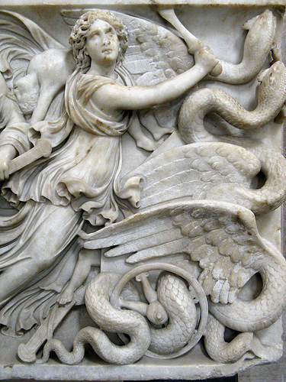
The Burial of the Dead
Medea:
No, indeed, my hand will bury them,
After bringing them to Hera’s shrine on the cliff,
So none of my enemies will insult them by pulling
Down their tombs. In this country of Sisyphus,
We shall assign a sacred feast and rituals
As a memorial of this impious murder forever after.
I myself am going to Erechtheus’ country,
Athens, to live with Aigeus, son of Pandion.
Since you are base, your death will be fittingly mean:
You’ll be struck on the head by a piece of your ship, Argo,
A bitter termination to your marriage with me.
1378-88

Slide 34
The cult of Medea’s children
… and the women of Corinth were planning to kill the children (because they didn’t want to be ruled by a foreign witch), seven boys and seven girls. When the children were being pursued, they fled to the sanctuary of Hera Akraia and sat there. But this did not hold the Corinthians back from them in any way, and they killed all of them on the altar. A plague started in the city, and many bodies were destroyed by the illness. When they consulted the oracle, the god told them to expiate the pollution of the children of Medea, and from then until our own time, each year the Corinthians chose seven boys and seven girls from the most distinguished families to spend a year in the precinct of the goddess and to appease with sacrifices the wrath of the children and the rage of the goddess on their account. (scholiast to Euripides, Medea 264)
NB: There's a rumour that the citizens of Corinth bribed Euripides to make Medea the killer of her own children in his play.

Slide 35
The cult of Medea’s children
As you go along another road from the market-place, which leads to Sicyon, you can see on the right of the road a temple and bronze image of Apollo, and a little farther on a well called the Well of Glauce. Into this they say she threw herself in the belief that the water would be a cure for the drugs of Medea. Above this well has been built what is called the Odeum Music Hall, beside which is the tomb of Medea's children. Their names were Mermerus and Pheres, and they are said to have been stoned to death by the Corinthians owing to the gifts which legend says they brought to Glauce.
But as their death was violent and illegal, the young babies of the Corinthians were destroyed by them until, at the command of the oracle, yearly sacrifices were established in their honor and a figure of Terror was set up. This figure still exists, being the likeness of a woman frightful to look upon but after Corinth was laid waste by the Romans and the old Corinthians were wiped out, the new settlers broke the custom of offering those sacrifices to the sons of Medea, nor do their children cut their hair for them or wear black clothes. (Pausanias 2.3.6-7)

Slide 36
Quiz Question
5. What reason does Medea give for killing her children?
a. they have been disloyal to her
b. she wants to hurt Jason
c. their sacrifice will save Corinth
d. she offers no reason

